Slide 1


Ai-Final term project
6
Implementation of reinforcement strategy
for tic-tac-toe player And comparing the results in python.
6
1
2
Preetam Narendra soni
Chunwang Yuan
Date: 12/06/2021

Slide 2
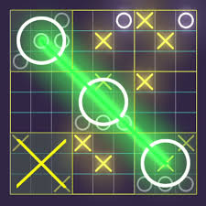
About us
Preetam Soni and Chunwang Yuan are Graduate students at University of New Haven.
Pursuing MS, Data Science(Batch-Dec 2022)

Slide 3
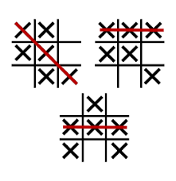
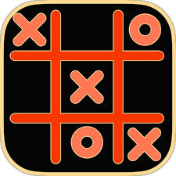
Tic-tac-toe
2-player game
Game play
winner
2 player are involved in this game placing assigned mark on 3x3 board
Each player is assigned ‘X’ or ‘O’ and they play turn –by-turn placing the mark on 3x3 board
Whoever get the 3 marks in straight line wins the game.
weather be in Row, Column or in diagonal
Quick game
Player a and player b
It is a quick game so the players can play multiple times and enjoy
Each player applies different strategies to block, defend, to make opponent lose the game.

Slide 4
idea
Implementation in python
Create board
Introduce players
Introduce strategies
Introduce gameplay and winner statistics

Slide 5
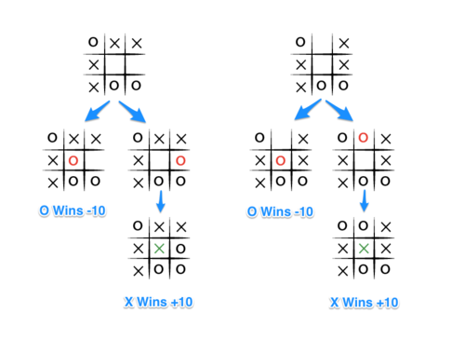
objective
Implement tic-tac-toe in python
Introduce players, gameplay , reinforcement strategies and compare them.
Make each player with certain strategy play 5000 games with other player with certain strategy
Train player with q-learning and make it win above 70% when played with random by storing the state results from previous state and rewards points for next game reference.

Slide 6
Analysis of q-learning strategy and random strategy over tic-tac-toe game
Steps involved:
Board creation
Game play
Q-learning strategy
Implement a flexible board, not just related to 3x3
How a player with a certain strategy approach the game play and win
Storing each reward and state value for future game_play reference and after certain games winning streak increases
Random strategy
Player
Printing analysis
I always used this strategy while playing tic tac toe. Selecting randomly from available states
Assigning strategy.
Getting payer value.
Moving the player
Reward for each game
Printed graph – total 4 bar plots
Each time each player has different strategy to play

Slide 7

System requirements
Python 3, PyCharm, pandas, matplotlib
Total 5 .py files, implemented in PyCharm and using pandas and matplotlib printed the statistics for comparison between the strategies.
Techniques/strategies
2 strategies implemented Q-learning and Random strategy
Each player takes 1 strategy and play 5000 games
Total 4 format of games: Q vs R, R vs Q, Q vs Q, R vs R
Printing bar plot
Printing bar plot and then comparing the wins, lose, draw between games

Slide 8
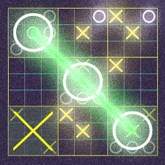

outcome
Implemented Q-learning and random strategies
Compared Q learning to a random strategy to see how Qlearning behaves and improves

Slide 9

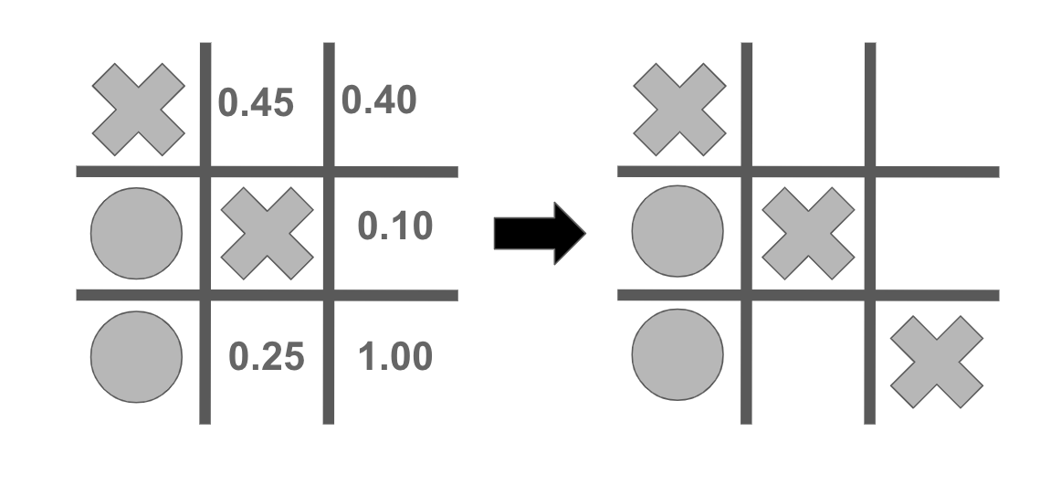
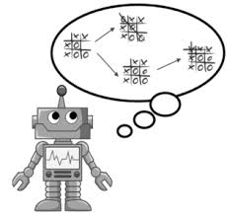
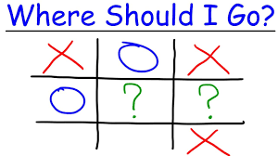
Understand about reinforcement, q-learning and random strategy
S
Q
vs
R

Slide 10
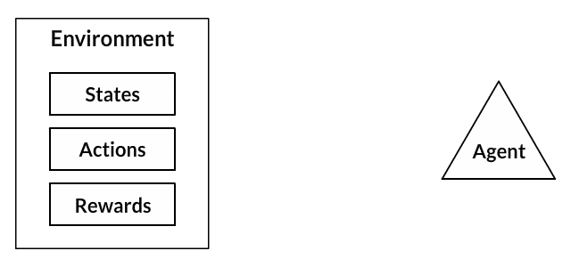
Reinforcement –q-learning quality learning
Research
Observation of the environment
Deciding how to act using some strategy
Acting accordingly
Receiving a reward or penalty
Learning from the experiences and refining our strategy
Iterate until an optimal strategy is found

Slide 11
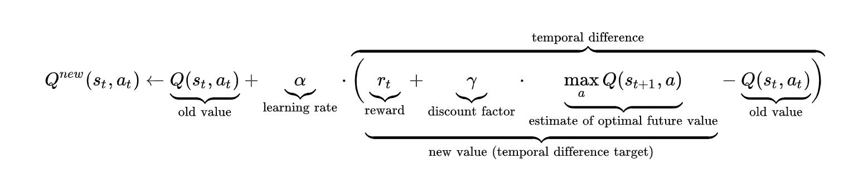
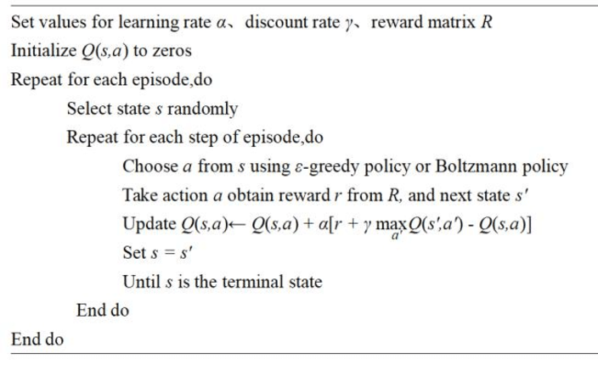
Q-learning

Slide 12
Implementing q-learning
Q values of all states initializing
Discount factor
Learning rate
0
0.8
0.2
[ ]
1/-1
Bar plot
Storing all states history
Reward
Storing all wins/loss/draw
July, 20XX

Slide 13
Implementing q-learning in python strategy.py
 | Function select move | Class Game | Class player | Main.py
Class Q_learning
Learning rate=0.2 | Find available moves | Assign the marks to each player | Assign the strategy to each player | Assign the number of games to be played
Decay/discount = 0.8 | Compare with exploratory rate | Using the move from strategy move the player | Using functions from strategy and game move the player | Record the wins and loss of each player
Exploratory rate =0.1 | Using compute hash function find the vaue of the state | Determine the winner |  | Storing them in list
Revenue @ 15% | Store the value as max value | Assign the reward |  | Using the bar plot to plot the statistics
 | Store the state as best state |  |  | Compare them after certain games
 | Now compute for all available states
 | Select the best state value and state
 | Using the play game function move the player
 | Once moved the state value is store in list for further reference

Slide 14
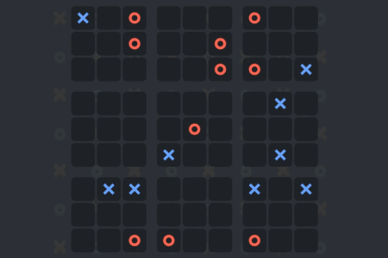
Random strategy
Research
Random strategy selects randomly from available moves and play.
This is a very general approach when initiating the game but may give tough time to opponent sometime
This approach helps us in making the game fair

Slide 15
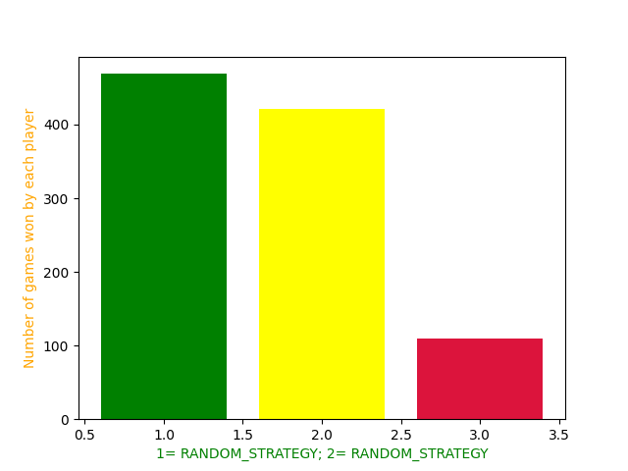
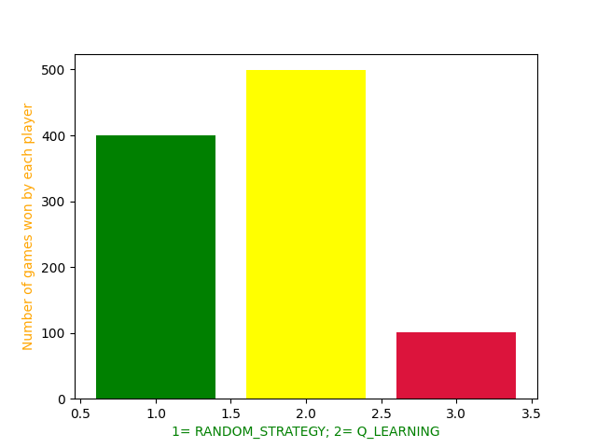
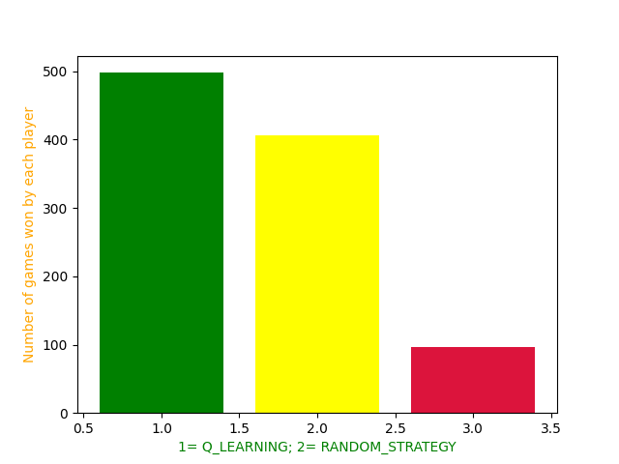
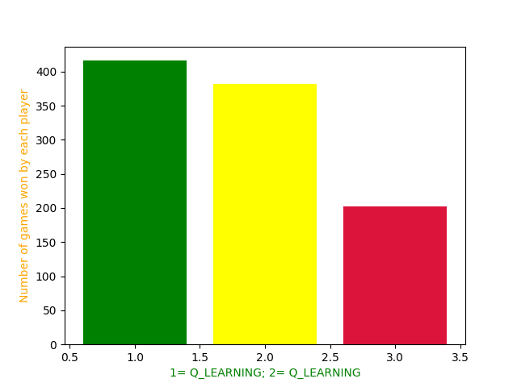
Our competition- 1000 games
random
Contoso Ltd.
Competitor A
Random
Q-learning
Competitor C
Competitor E
Competitor D
Competitor B
Q-learning

Slide 16
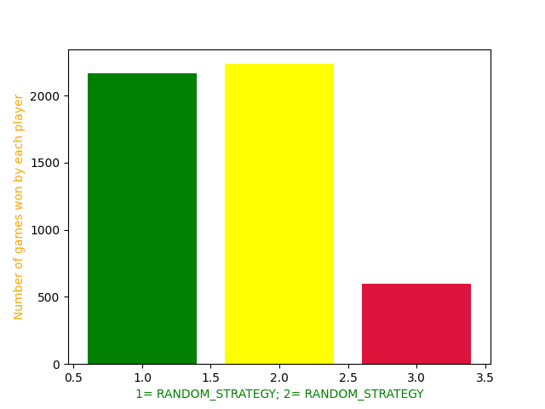
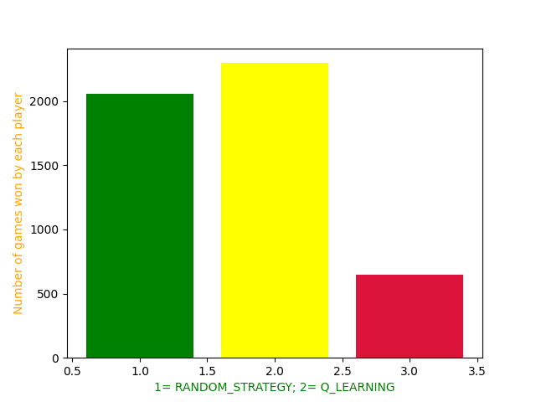
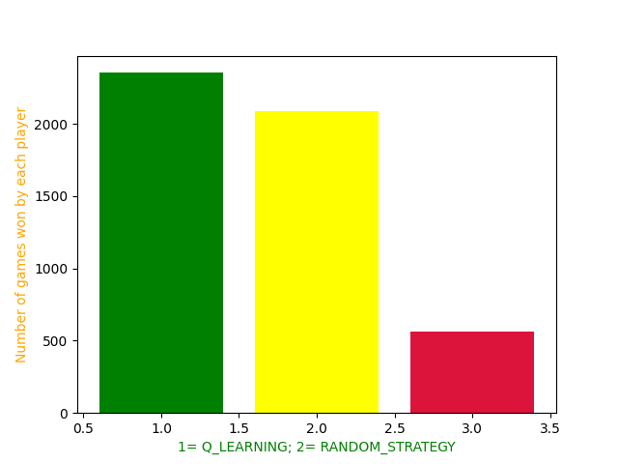
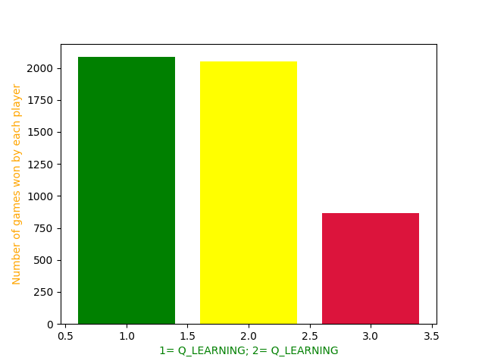
Our competition- 5000 games
random
Contoso Ltd.
Competitor A
Random
Q-learning
Competitor C
Competitor E
Competitor D
Competitor B
Q-learning

Slide 17
Scaling wins by q learning
After 5000 games
Q –learning defeated Random strategy and had higher edge on all games
Q vs q
initially there was difference but as soon as they number of games increase, they both had equal wins, loss and draw
Q vs r and r vs q
Initially q was losing when test for 10 games but as games increased to 1000 q learning was on higher side

Slide 18
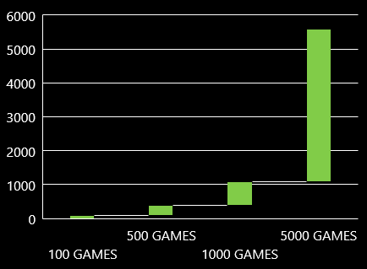
Traction
5000 game metrics
Q-learning wins
 | Q vs R | R vs Q | Q vs Q | R vs R
Q wins | 2500 | 2500 | 2100-Q-Player 1 | 2000-R-player1
R wins | 2000 | 1900 | 2100-Q-player2 | 2400-R-player 2
Draw | 500 | 600 | 800-draw | 600
20XX | 5000 | 5000 | 5000 | 5000

Slide 19


Meet the team
CHUNWANG YUAN
PREETAM N SONI
MS, DATA SCIENCE
MS, DATA SCIENCE

Slide 20

Summary
We implemented reinforcement learning over tic tac toe game in python using python 3.6, PyCharm, pandas and matplotlib.
We got the statistics using bar plot to compare the wins for Q-learning over Random and tested them for 5000 games.
Q-learning after going over the 5000 games is indeed the best strategy to win max games with random strategy .

Slide 21


Thank you
Preetam Narendra Soni
Pritam.soni4949@gmail.com
Chunwang Yuan
18817565924@163.com

Slide 22
Reference:
https://www.learndatasci.com/tutorials/reinforcement-q-learning-scratch-python-openai-gym/
https://pypi.org/project/pyqlearning/
https://towardsdatascience.com/simple-reinforcement-learning-q-learning-fcddc4b6fe56#:~:text=Q%2Dlearning%20is%20an%20off,a%20policy%20isn't%20needed
https://medium.com/ai%C2%B3-theory-practice-business/reinforcement-learning-part-6-td-%CE%BB-q-learning-99cdfdf4e76a

